Slide 1
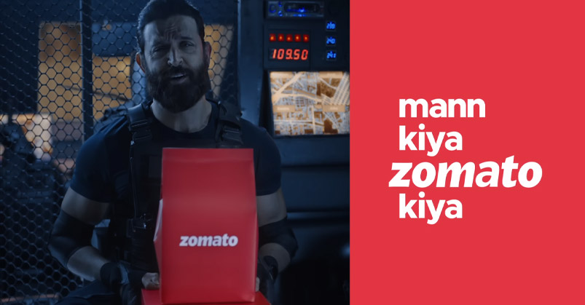
Zomato Bangalore Restaurant Data Analysis
Team - 2

Slide 2
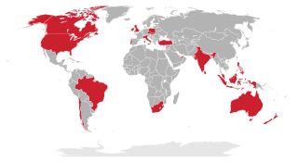
Zomato Food Delivery service is available in 24 countries and more than 10,000 cities as of 2019
Zomato is an Indian Unicorn company that started as FoodieBay back in 2008 + It was renamed as Zomato in November 2010 » Zomato has become one of the world’s biggest foodtech companies with market valuation of $14 Billion.
Zomato Bangalore has more than 12000 restaurants. Bangalore city is because it is 3rd largest city in India, 27th largest city all over the world and Bangalore is referred as “IT capital of India” which follows different food culture. Restaurants from all over the world can be found here. Different types of restaurants and with variety of cuisines with over 15 million population

Slide 3
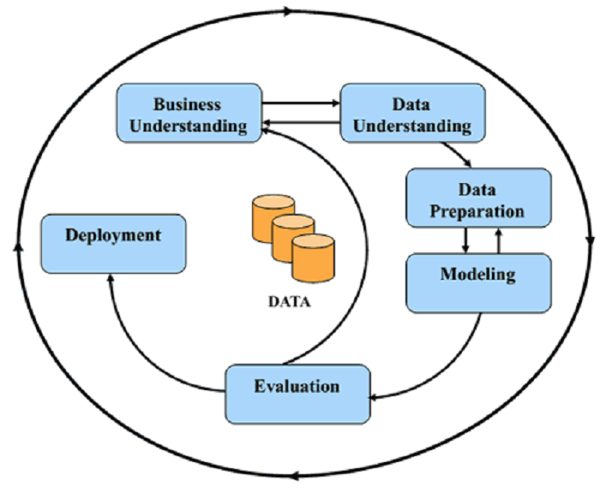
A description & Preparing of the dataset
It contains around 51717 rows and 17 columns of data. columns/features such as URL, Address, Name, Online_order, Book_table, Rating, Phone number, Location, Restaurant type, Dish liked, Cuisines, Average cost for 2 persons, Reviews_list, Menu and more.

Slide 4
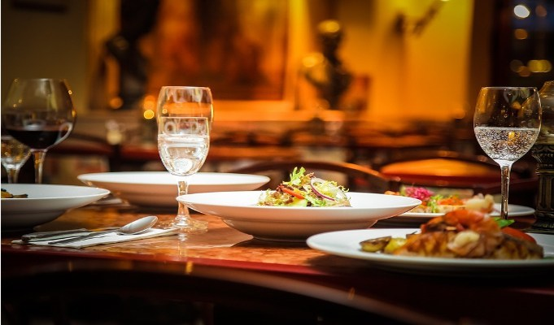
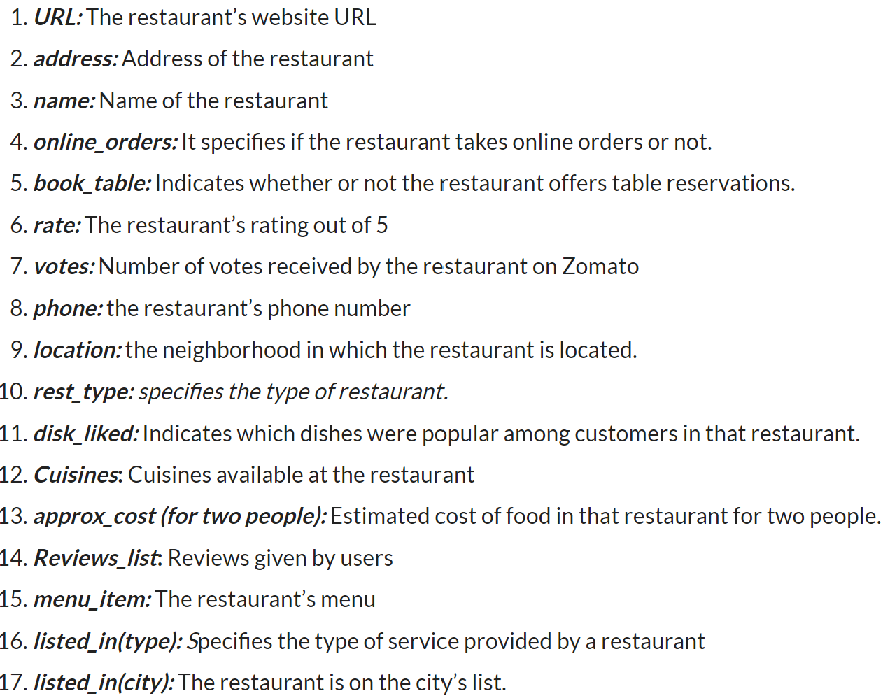
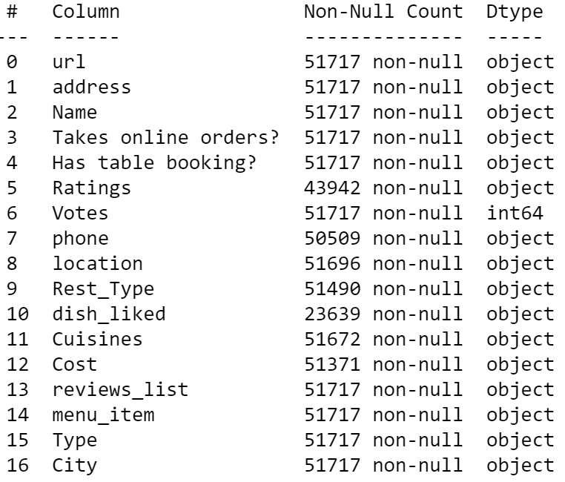
Dataset Details
It contains around 51717 rows and 17 columns of data. The attributes in the dataset are as follows:

Slide 5

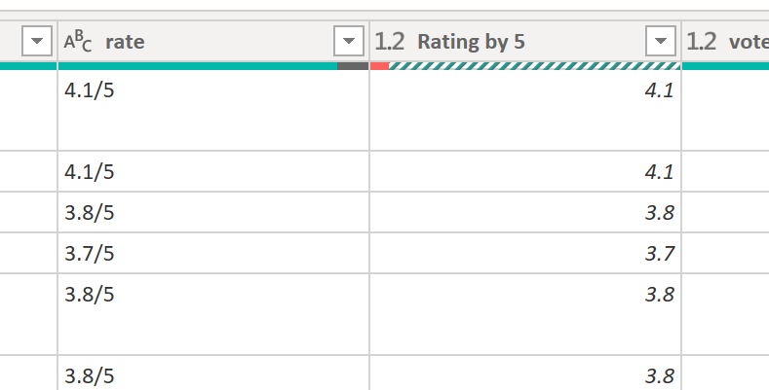
Data Cleaning
Columns- Rating Column separate and create a decimal type column for measurement. Check all other columns for null-blacks.

Slide 6

Additional Measurement Added
Add new measurement as High-Low Rating from the average Rating
Add new measurement as High-Low Priced from the average cost

Slide 7
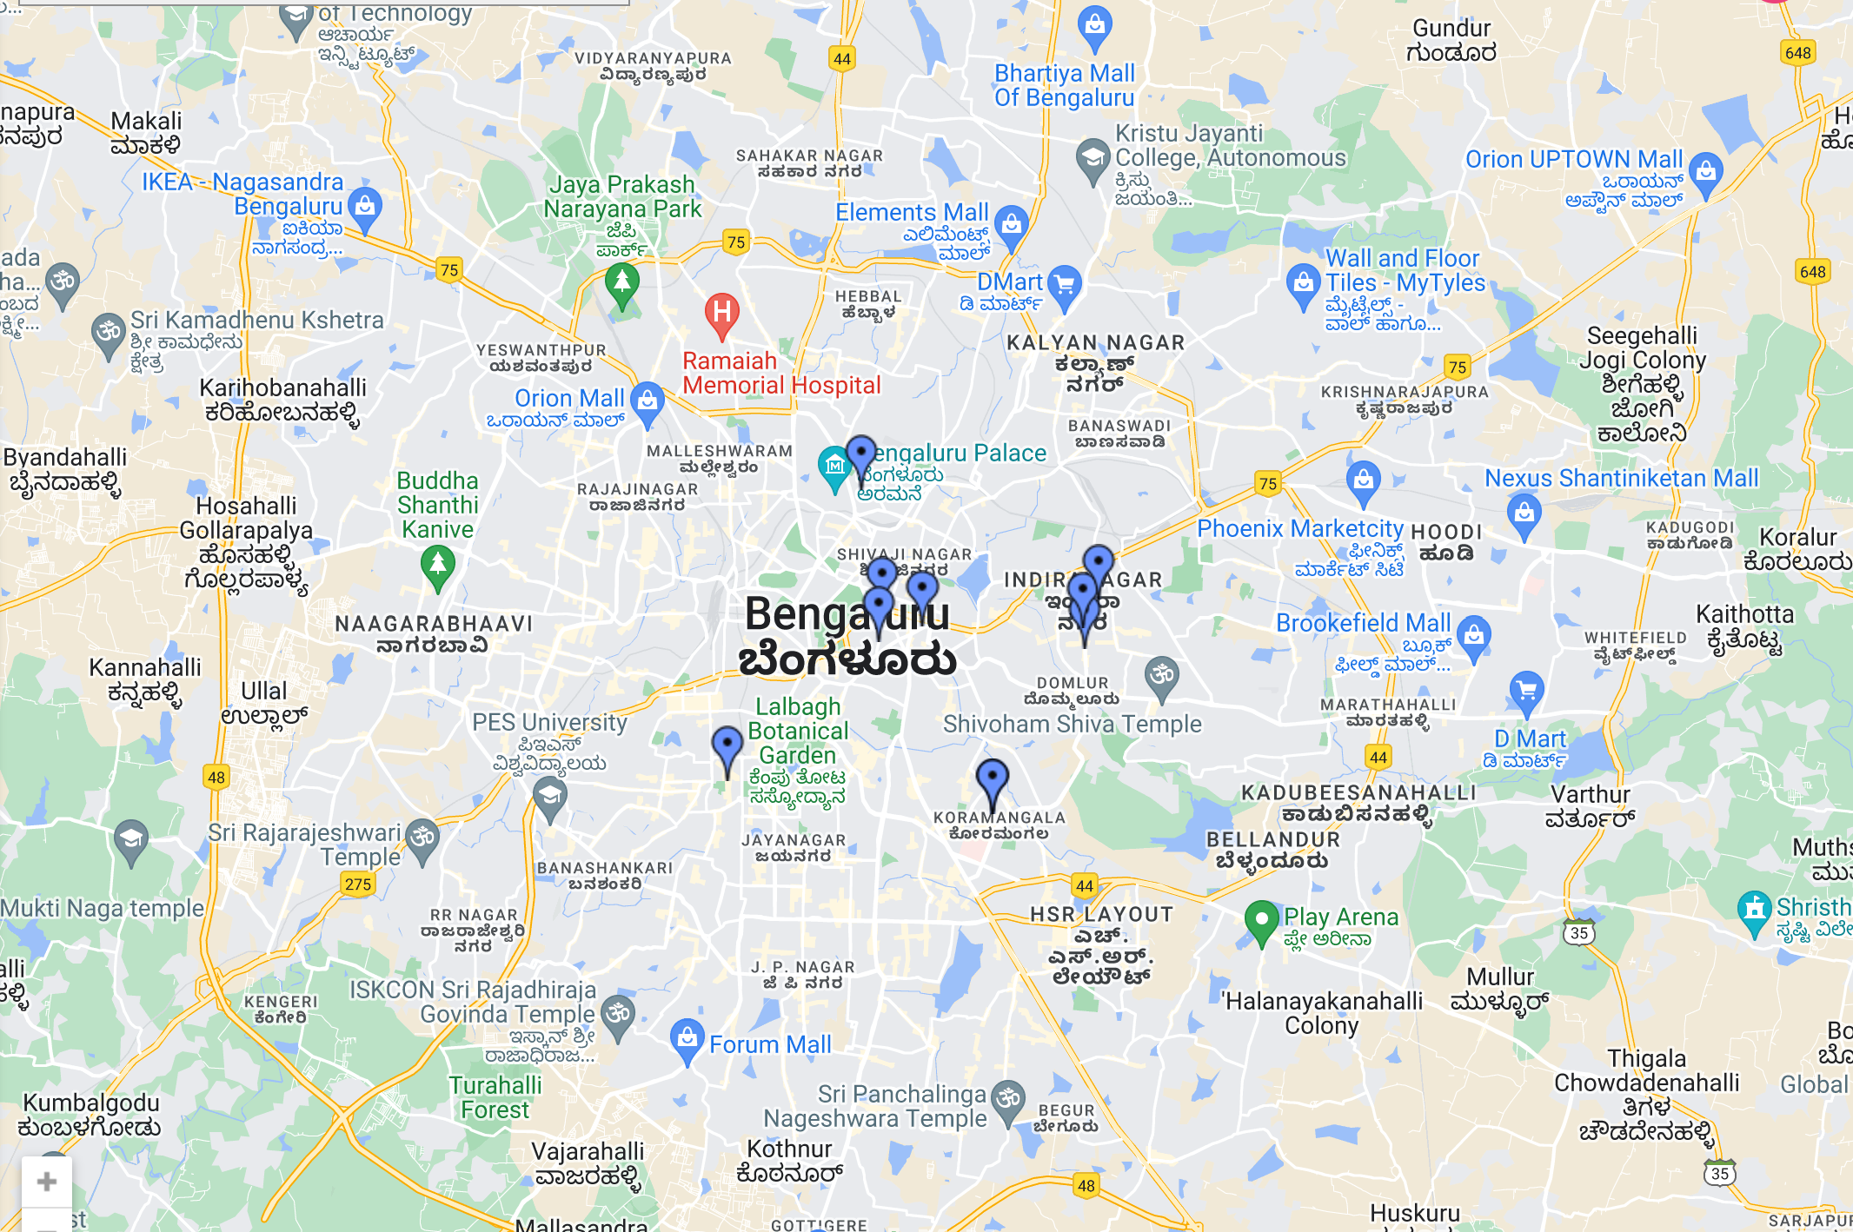
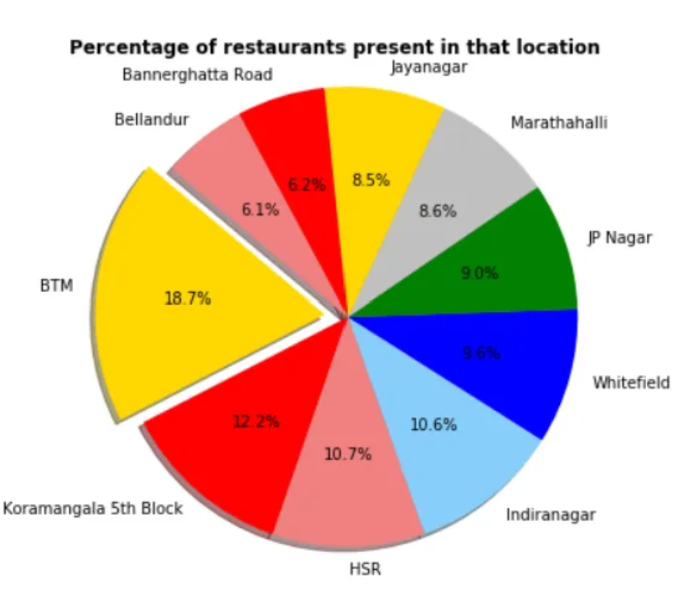
Location of Restaurants

Slide 8
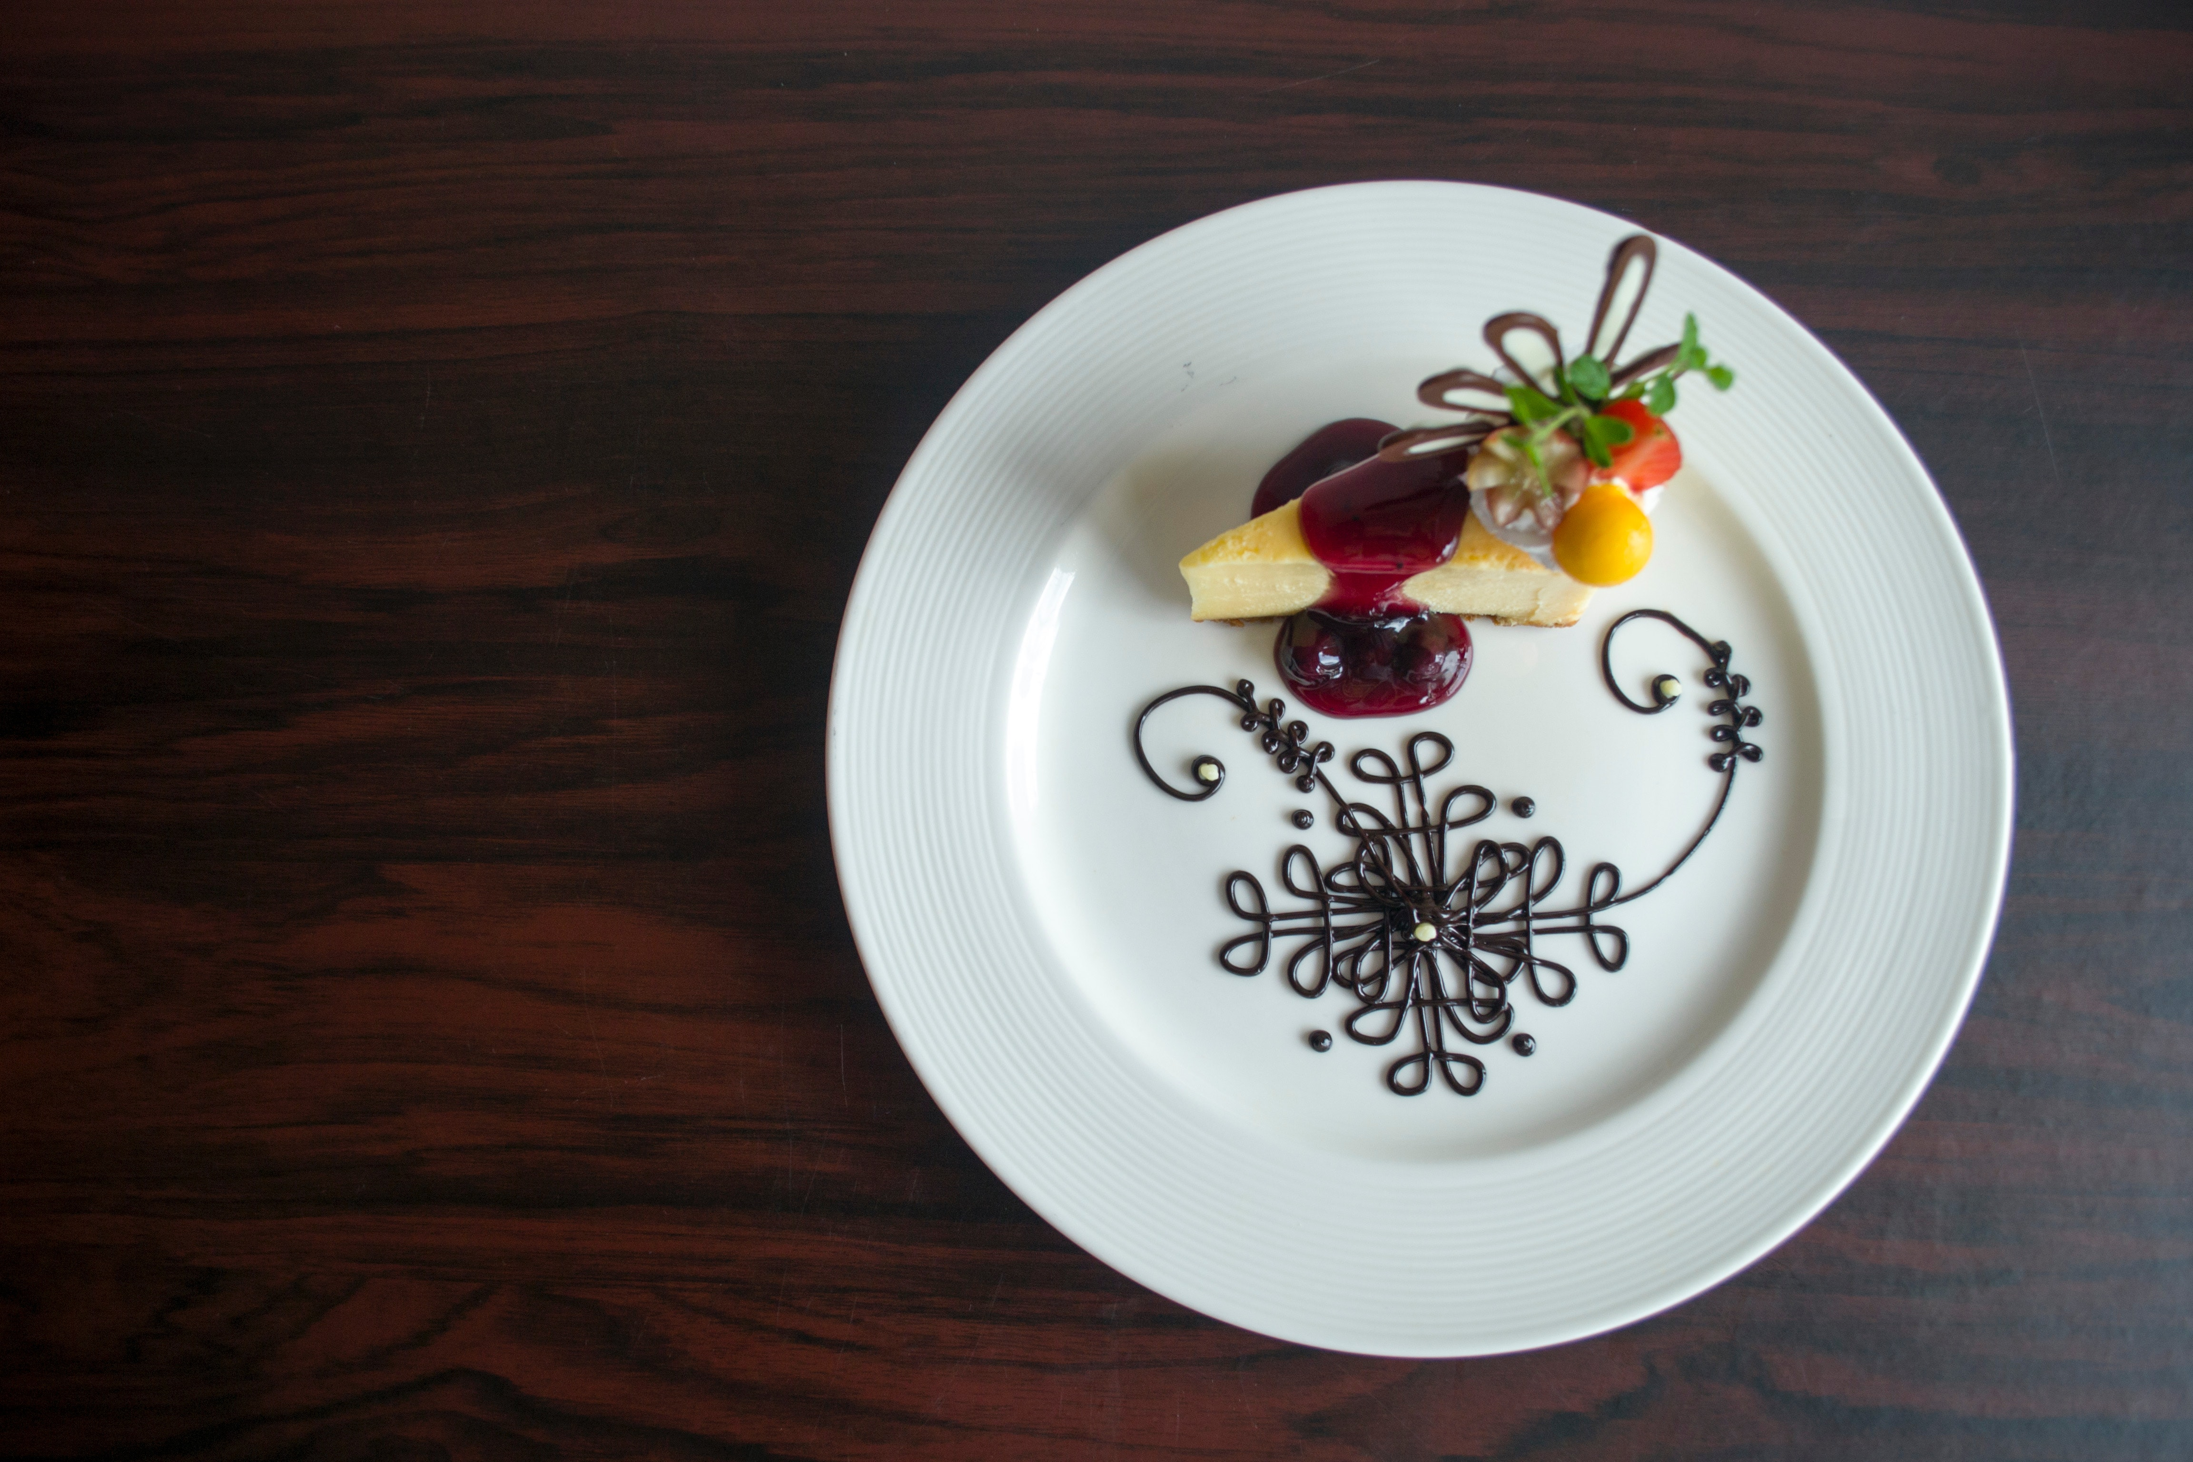
Thank You for Your Attention
Let's move to Data analysis presentation

